Slide 2
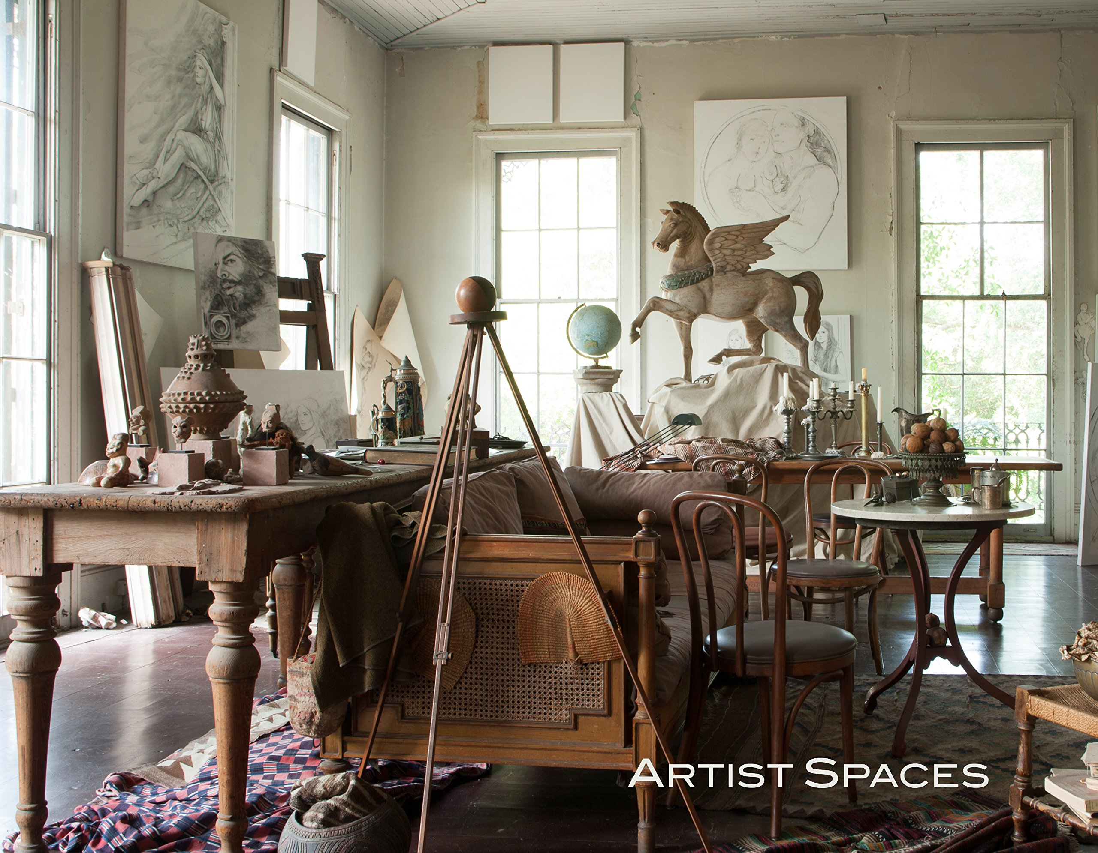
To see photos of the following artists’ workspaces, check out the book
Artist Spaces: New Orleans by Tina Freeman.

Slide 3
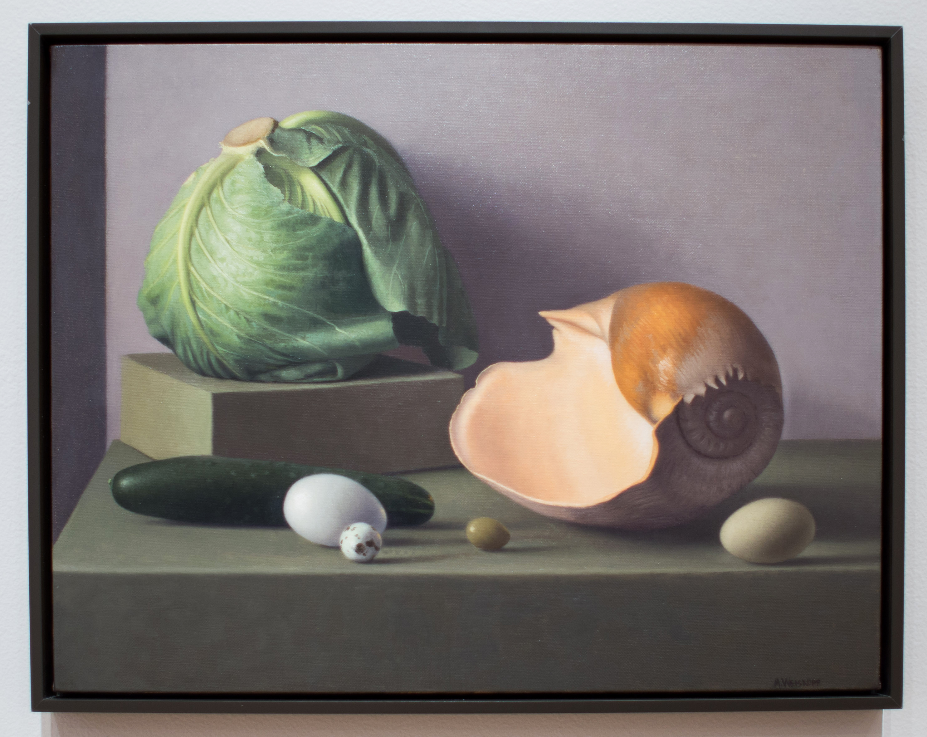
Amy Weiskopf. Still Life with Cabbage and Shell,2014. Oil on canvas

Slide 4
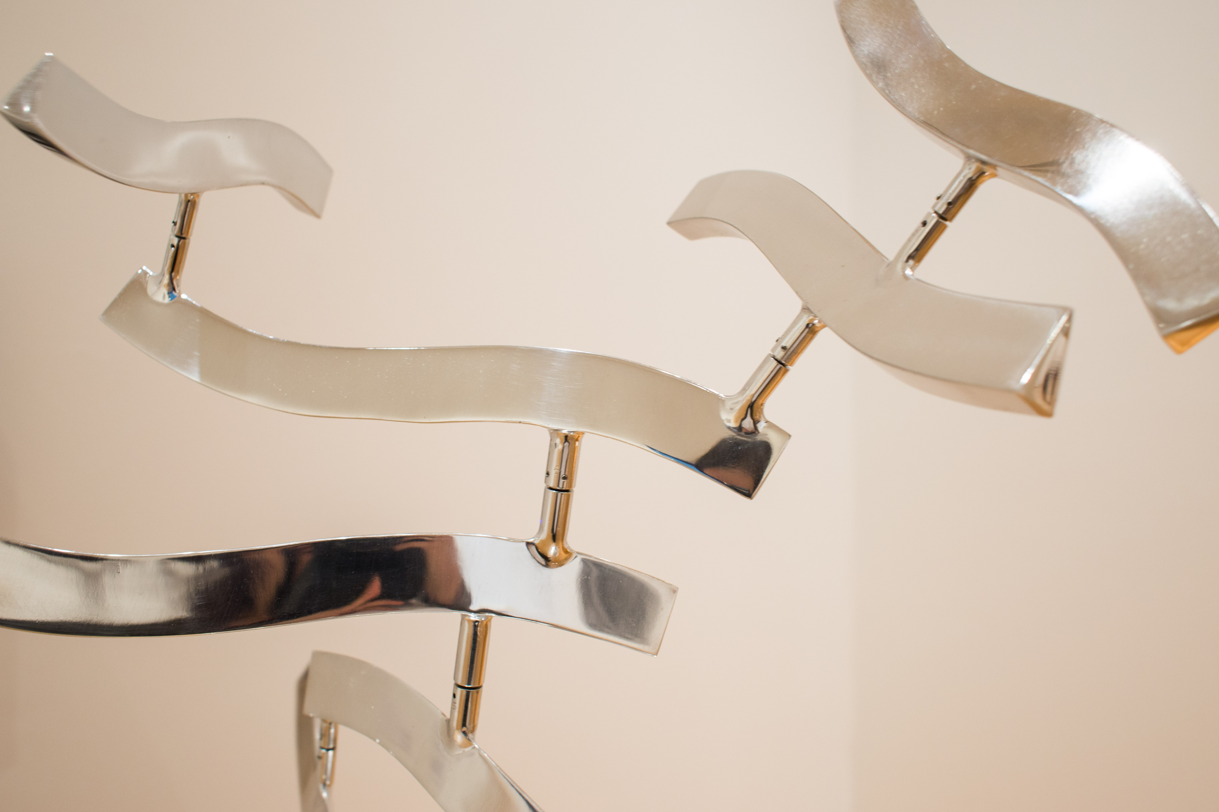
Lin Emery. Anole,2016. Polished aluminum.

Slide 5
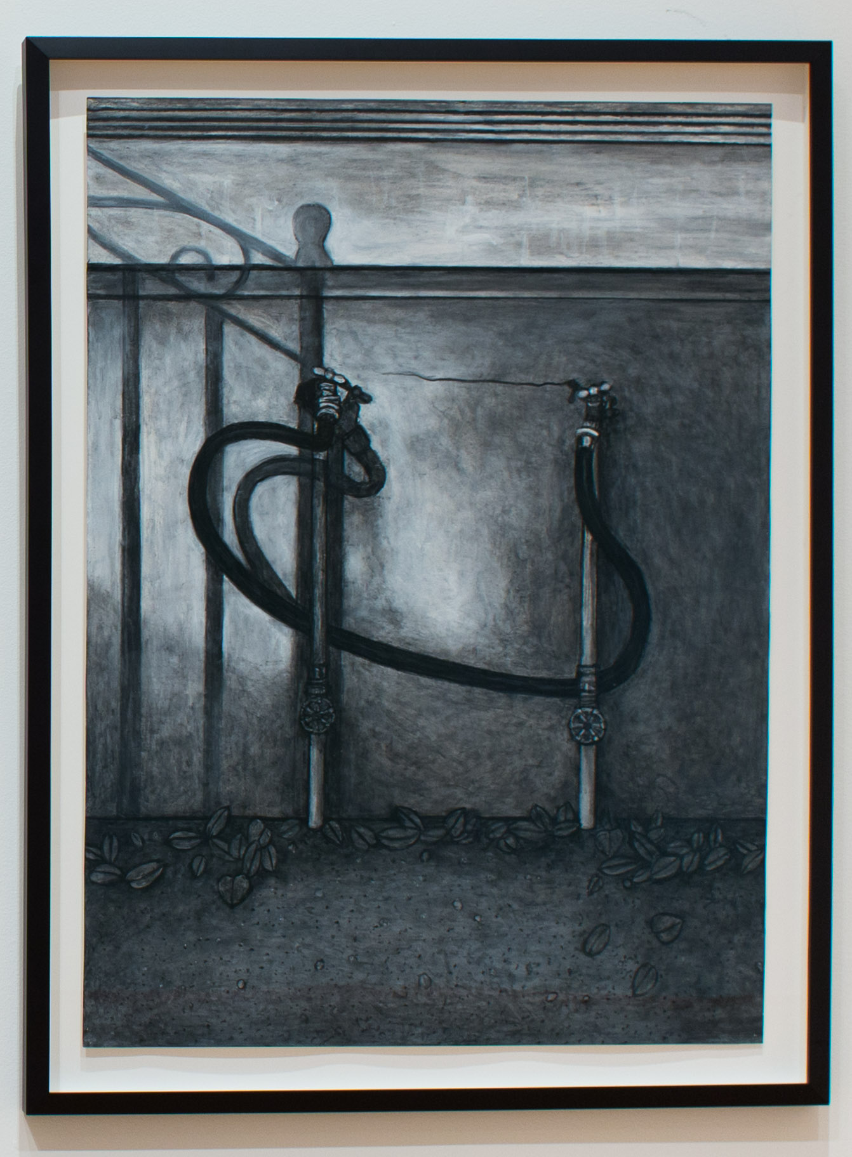
Willie Birch. Connected,2013. Charcoal and acrylic on paper

Slide 6
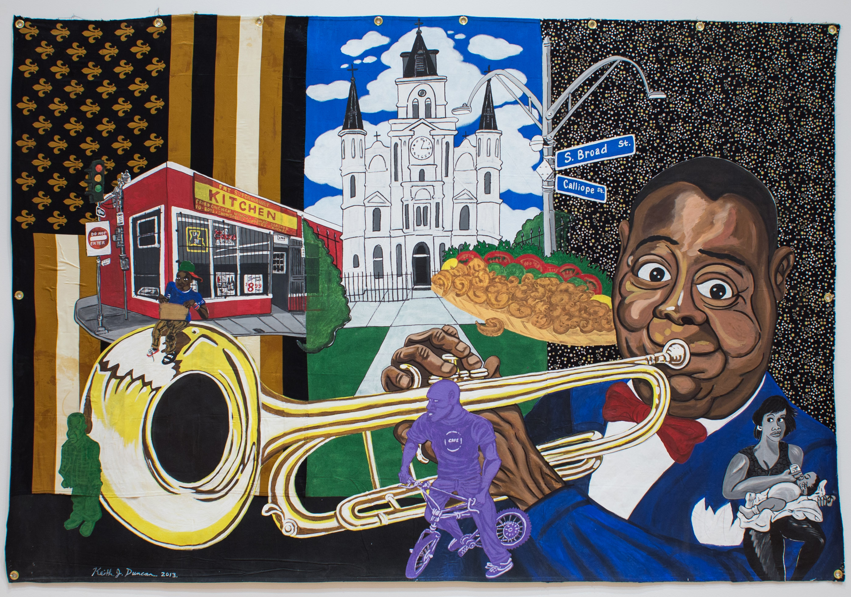
Keith Duncan. King of New Orleans,2013. Acrylic on fabric.

Slide 7
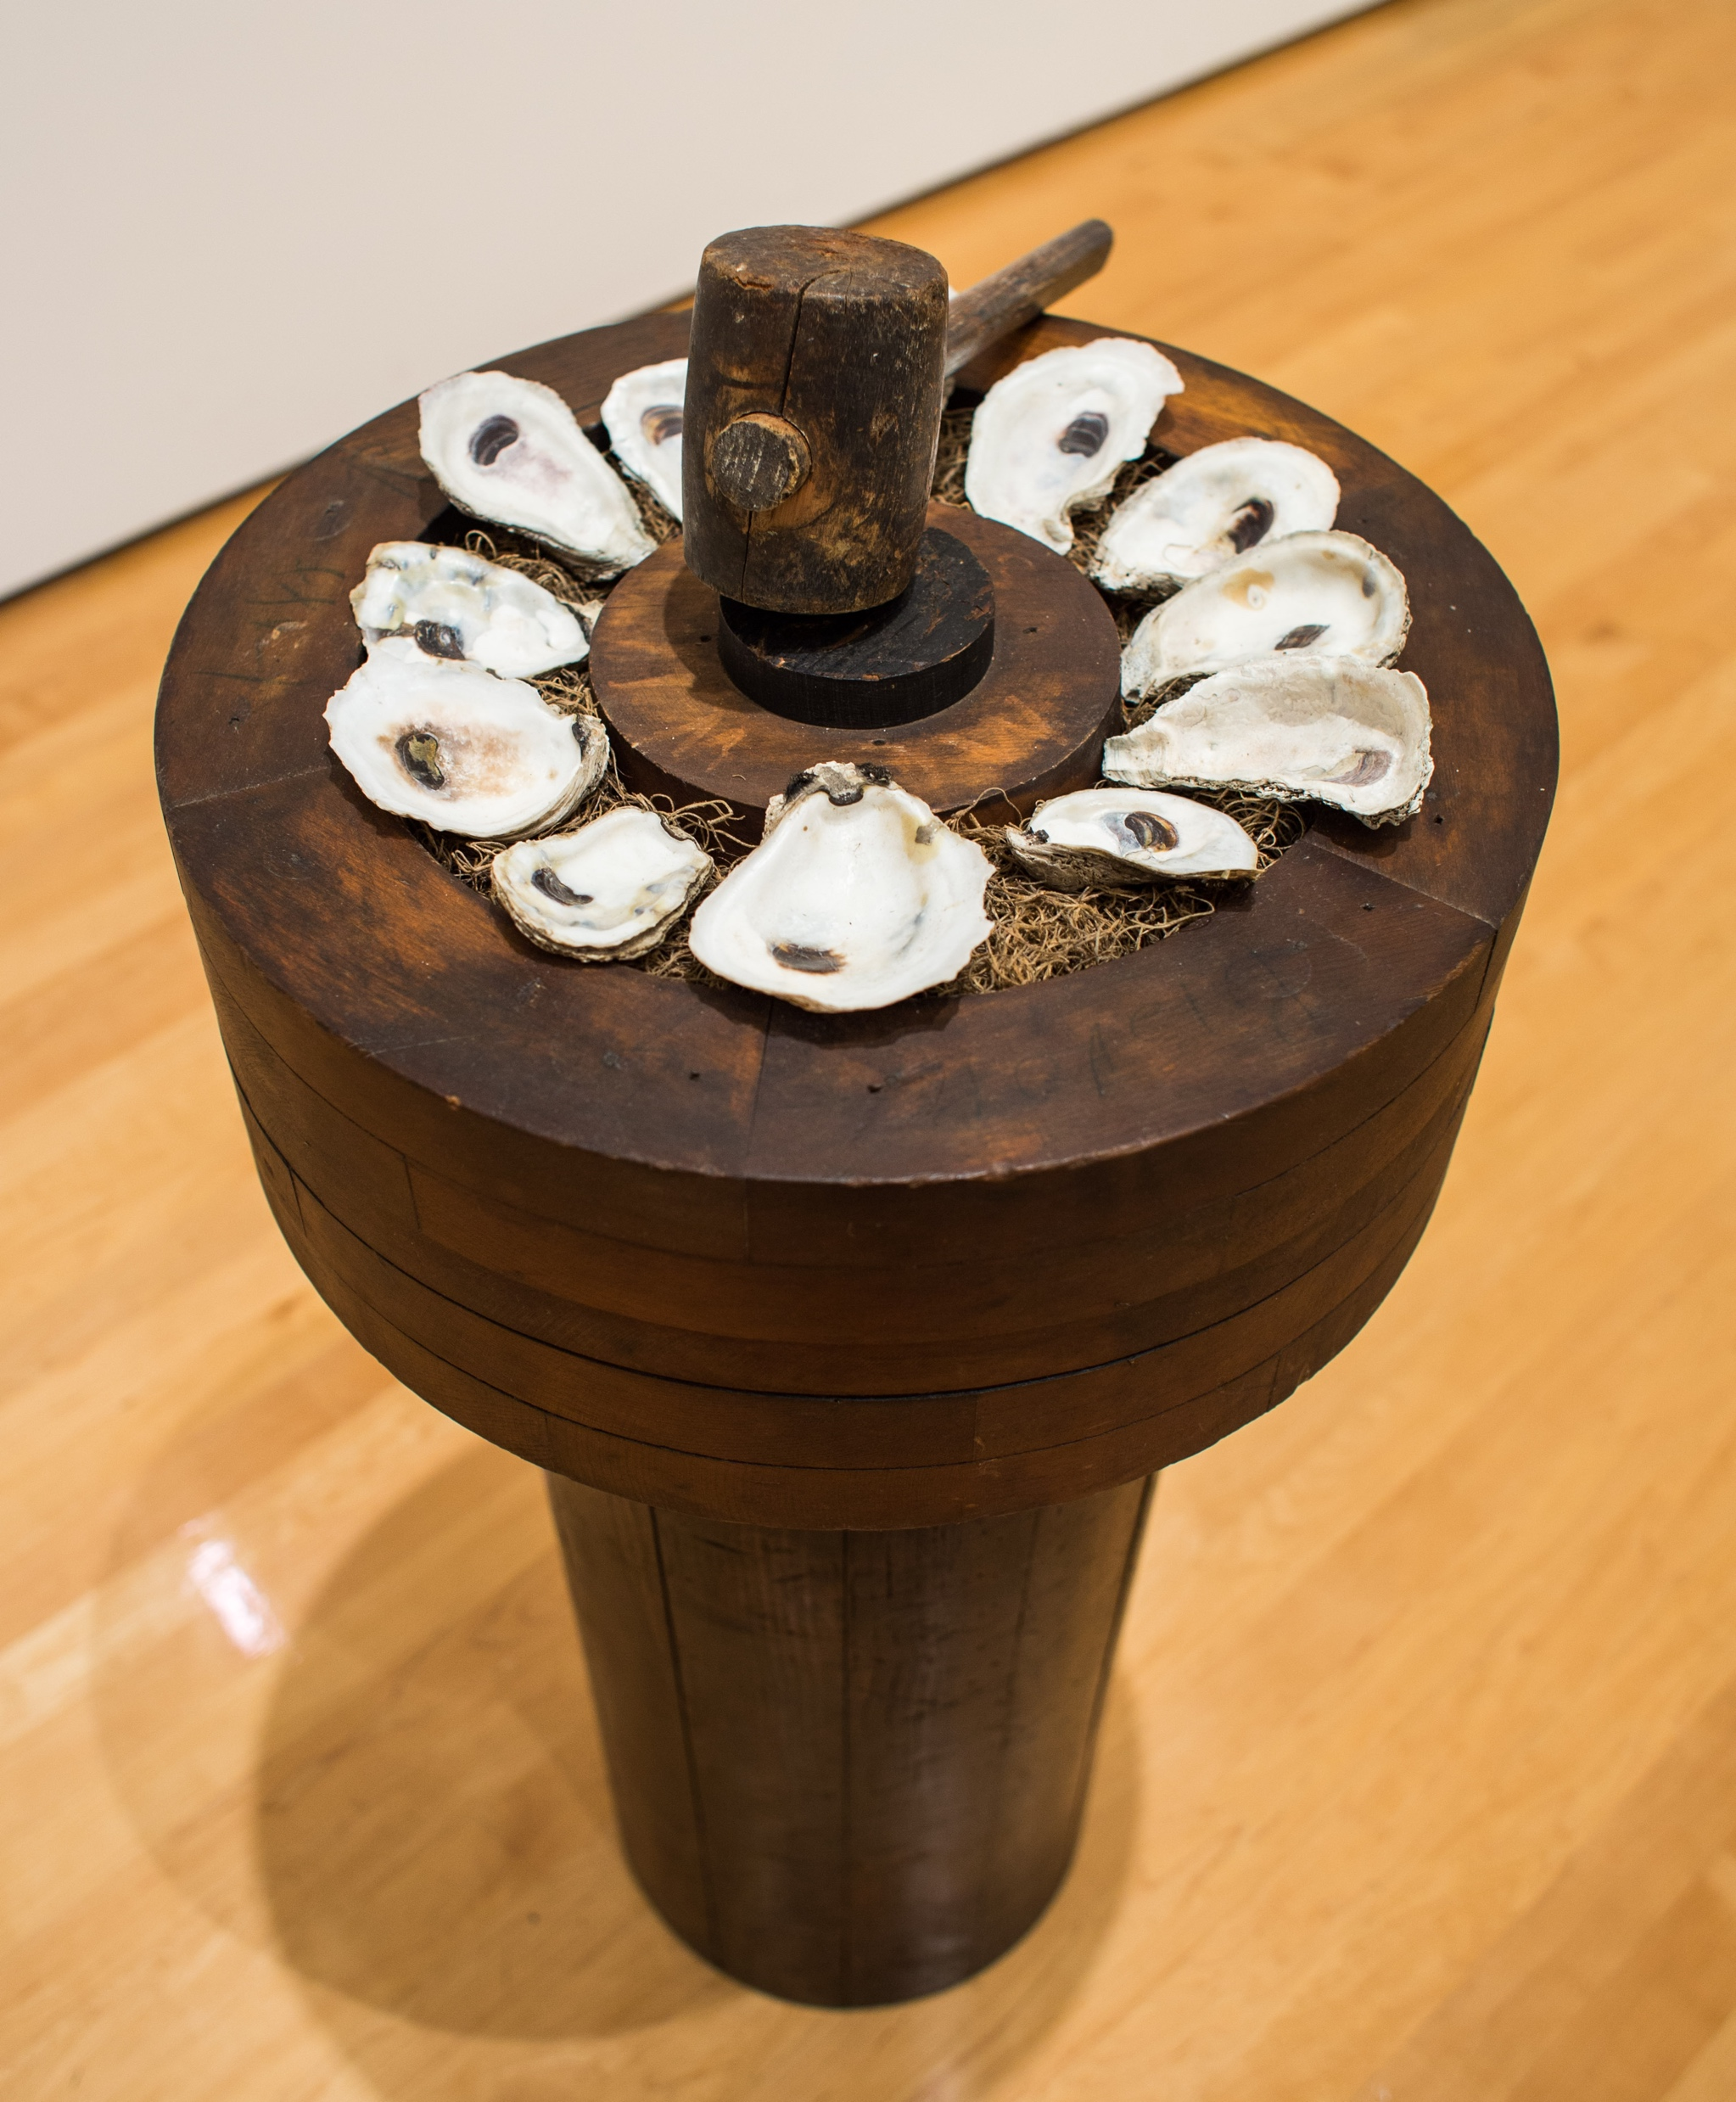
Elizabeth Shannon. Oyster Crusher, Berwick Bay, 2010. Wood base, moss, oyster shells, wood mallet.

Slide 8
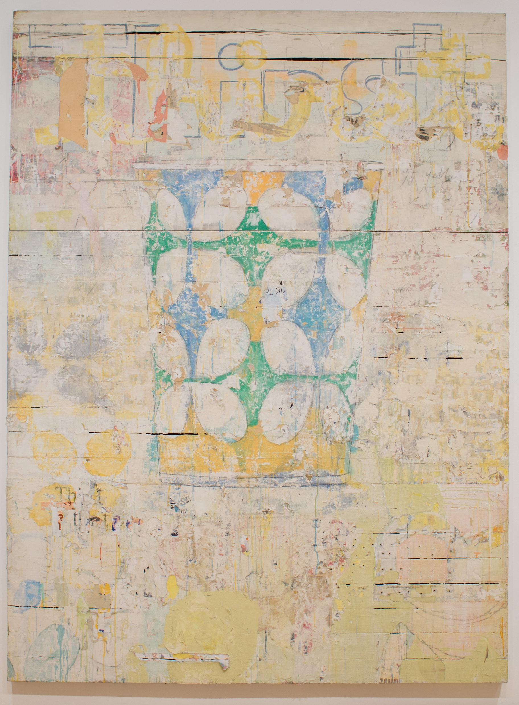
Nicole Charbonnet. Thirst,1999. Mixed media on board; collaged paper, oil, gesso

